Slide 1
Hotel Booking Analysis
EDA Capstone Project
AlmaBetter
KAMATAM HARSHITH
LAKSHMI KEERTHANA
TITO VARGHESE
ANMOL RAJ

Slide 2
Agenda
Data summary
Data cleaning
Hotel wise analysis
Distribution Channel wise analysis
Cancellation related analysis
Time and Stay related analysis
Heat Correlation
Challenges
Points to Discuss

Slide 3
Agenda
To extract,observe and analyse the given hotel bookings data set from 2015-2017.
The analysis of given data set in following ways :
Hotel wise analysis
Distribution Channel wise analysis
Booking cancellation analysis
Timewise analysis

Slide 4
Data Summary
Given data set has different columns of variables crucial for hotel bookings:
hotel: The category of hotels, which has two values resort hotel and city hotel.
is_cancelled : The value of column show the cancellation type. If the booking was cancelled or not. Values[0,1], where 0 indicates not cancelled.
lead_time : The time between reservation and actual arrival .
stayed_in_weekend_nights: The number of weekend nights stay per reservation
stayed_in_weekday_nights: The number of weekday nights stay per reservation.
meal: Meal preferences per reservation.[BB,FB,HB,SC,Undefined]
Country: The origin country of guest.
market_segment: This column show how reservation was made and what is the purpose of reservation. Eg, corporate means corporate trip, TA for travel agency.
distribution_channel: The medium through booking was made. [Direct,Corporate,TA/TO,undefined,GDS.]
Is_repeated_guest: Shows if the guest is who has arrived earlier or not.Values[0,1]-->0 indicates no and 1 indicated yes person is repeated guest.
days_in_waiting_list: Number of days between actual booking and transact.
customer_type: Type of customers( Transient, group, etc.)

Slide 5
Data information
# Column Non-Null Count Dtype
--- ------ -------------- -----
0 hotel 119390 non-null object
1 is_canceled 119390 non-null int64
2 lead_time 119390 non-null int64
3 arrival_date_year 119390 non-null int64
4 arrival_date_month 119390 non-null object
5 arrival_date_week_number 119390 non-null int64
6 arrival_date_day_of_month 119390 non-null int64
7 stays_in_weekend_nights 119390 non-null int64
8 stays_in_week_nights 119390 non-null int64
9 adults 119390 non-null int64
10 children 119386 non-null float64
11 babies 119390 non-null int64
12 meal 119390 non-null object
13 country 118902 non-null object
14 market_segment 119390 non-null object
15 distribution_channel 119390 non-null object
dtypes: float64(4), int64(16), object(12)
No. of Rows : 119390 entries, 0 to 119389
No. of Data columns : 32 columns
16 is_repeated_guest 119390 non-null int64
17 previous_cancellations 119390 non-null int64
18 previous_bookings_not_canceled 119390 non-null int64
19 reserved_room_type 119390 non-null object
20 assigned_room_type 119390 non-null object
21 booking_changes 119390 non-null int64
22 deposit_type 119390 non-null object
23 agent 103050 non-null float64
24 company 6797 non-null float64
25 days_in_waiting_list 119390 non-null int64
26 customer_type 119390 non-null object
27 adr 119390 non-null float64
28 required_car_parking_spaces 119390 non-null int64
29 total_of_special_requests 119390 non-null int64
30 reservation_status 119390 non-null object
31 reservation_status_date 119390 non-null object

Slide 6
Data Cleaning
Data Cleaning is a crucial step before EDA as it will remove the ambiguous data that can affect the outcome of EDA.
While cleaning data we will perform the following steps:
1) Remove duplicate rows (df1[df1.duplicated()].shape)+df1.drop_duplicates(inplace = True)
No. of duplicate rows : 31980
2) Handling missing values. (hotelbookings.isnull().sum().sort_values(ascending=False)
hotelbookings[['company','agent']] = hotelbookings[['company','agent']].fillna(0)
hotelbookings['children'].fillna(hotelbookings['children'].mean(), inplace = True)
hotelbookings['country'].fillna('others', inplace = True)
3) Convert columns to appropriate data types. (df1[['children', 'company', 'agent']] = df1[['children', 'company', 'agent']].astype('int64'))
4) Removing the Outliers (adr,lead_time,days_in_waiting_list,required_car_parking_space)

Slide 7
Hotel wise analysis
Hotel with higher bookings cancellation rate.
Hotel with longest waiting time
Hotel with most revenue.
Chances of customer returning to hotel for another stay
Factors Governing Booking
Special requests by the guests

Slide 8
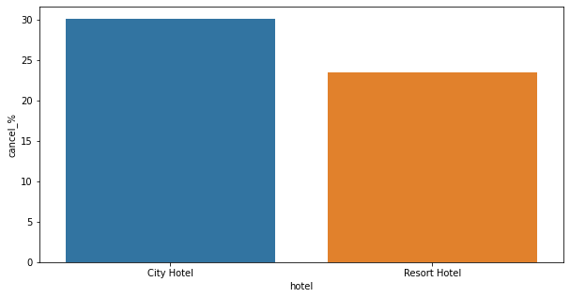
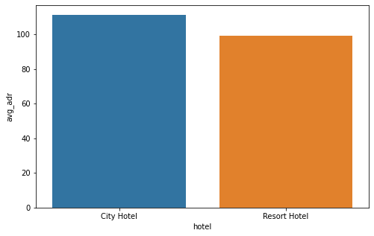
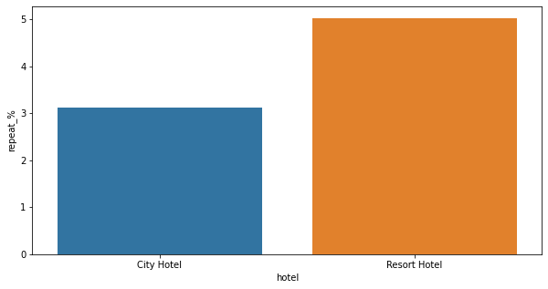
Hotel with higher bookings cancellation rate
Hotel with most revenue
30% of customers of City Hotel have cancelled their booking.Whereas 20-25% of customers have cancelled their booking in Resort Hotel.
City hotel generates most revenue.
Both the customers have less chances of its customer returning for the stay.
Chances of customer returning to hotel
for another stay

Slide 9
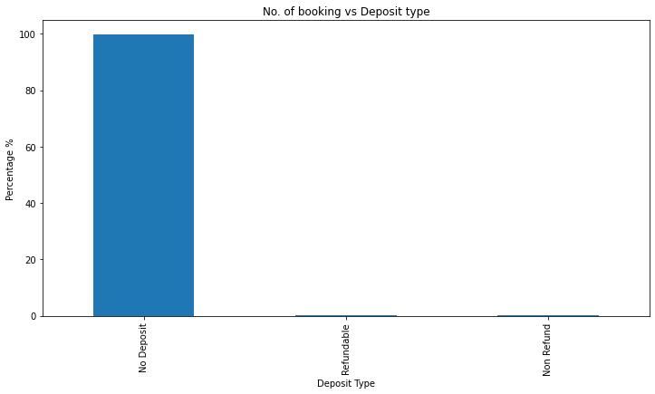
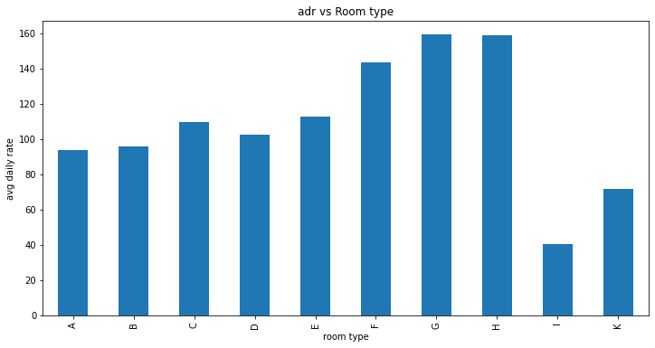
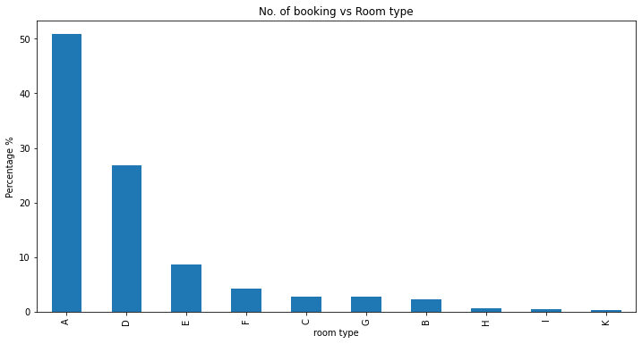
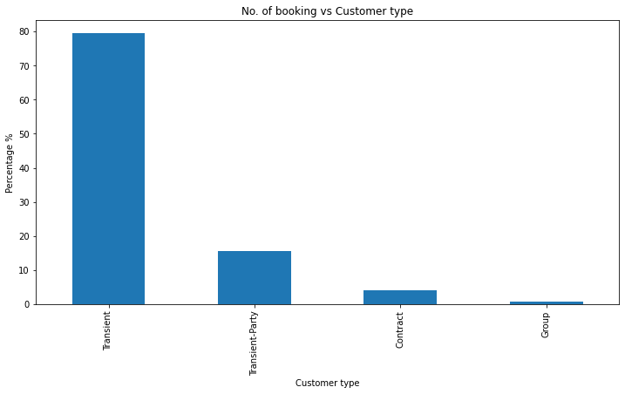
Factors governing booking
Deposit type
Room type vs adr
Room type with highest no. of bookings
Most number of customers used No Deposit option
Room type A has the highest number of bookings compared to the other room types.
The most number of bookings was made by Transient Customer Type and the least was by Group customer type..
Customer Type

Slide 10
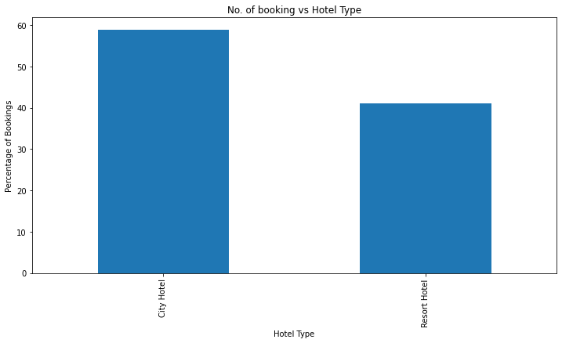
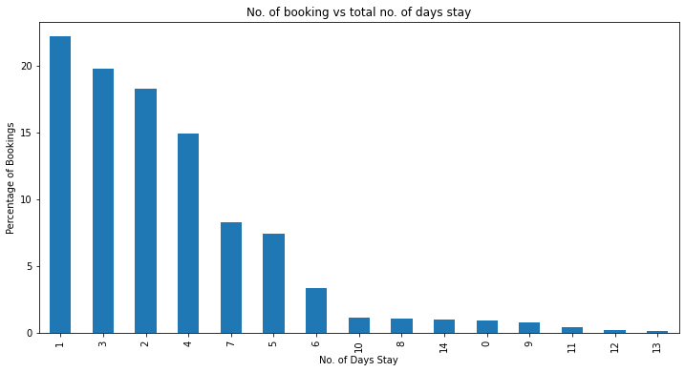
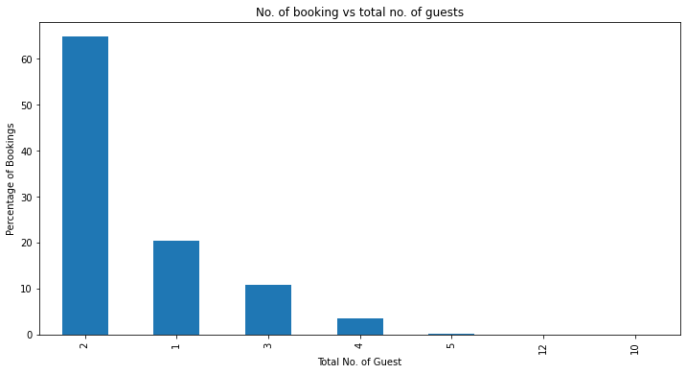
Hotel Type
Total number of days stays
Most preferred hotel was City Hotel.
The number of days stay was mostly 1
Most number of bookings was done by couples.
Total Number of Guest

Slide 11
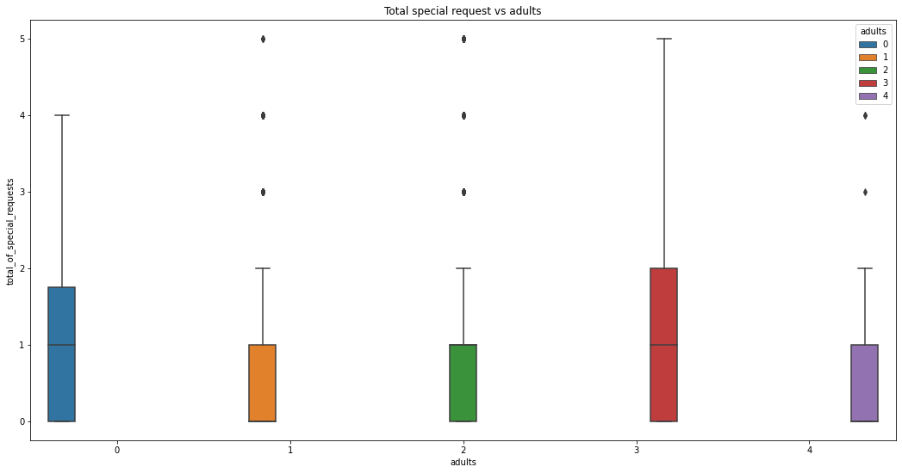
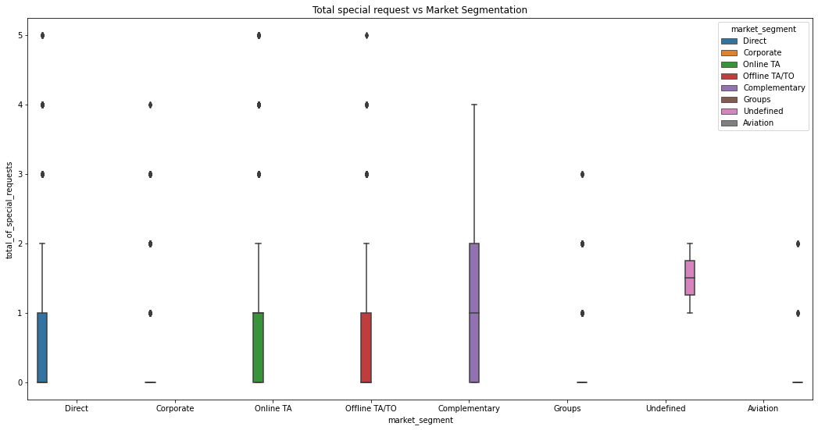
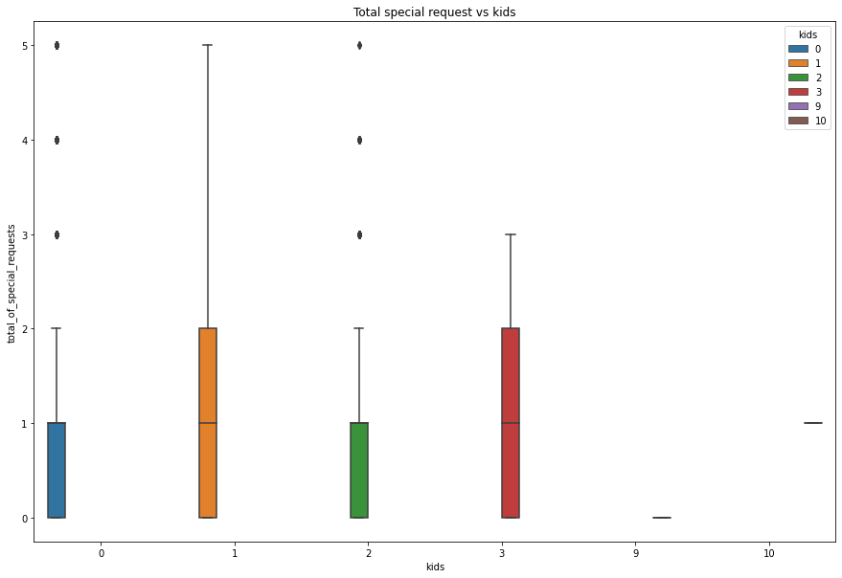
Special requests by the guests
Special Requests According to Adults
Special Requests According to Market Segmentation
Special Requests According to Kids
The most number of special request demand was from Complementary market segment.
The cases where the number of adults is more than 3 ,there was a high demand of special requests.
When the no. of kids were 1 and 3, we can expect more special requests.

Slide 12
Distribution Channel wise analysis
Most used Distribution Channel
Which distribution channel brings better revenue generating deals for hotels?
Market segments used by the guests
Distribution Channel with highest cancellation

Slide 13
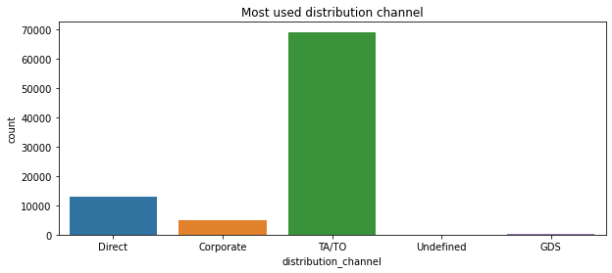
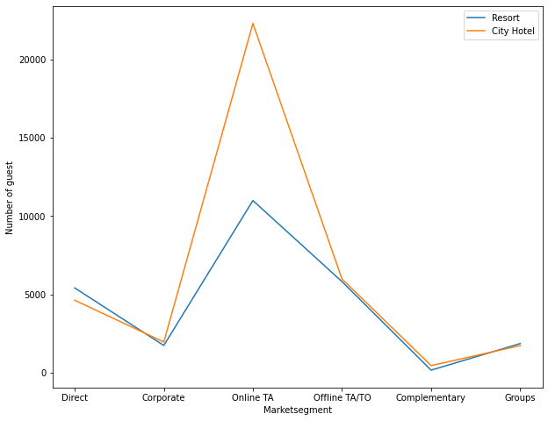
Most used distribution channel
Most used market segment
Most number of customers have used TA/TO(Travel Agency/Travel Operator) distribution channel for hotel bookings.
Mostly used market segment by the guests was Online TA to book City hotel and Resort hotel.

Slide 14
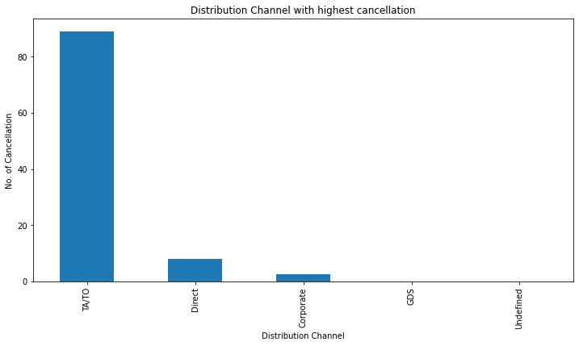
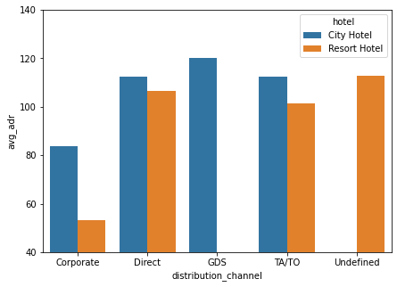
Distribution channel bringing highest revenue generating deals
Distribution Channel with highest cancellation
GDS channel brings higher revenue for City hotel. Whereas for Resort hotel gets more revenue by direct and TA/TO channel.

Slide 15
Cancellation related Analysis
Waiting time(days)
Lead Time
Cancellation for not assigning same room
Car parking space

Slide 16
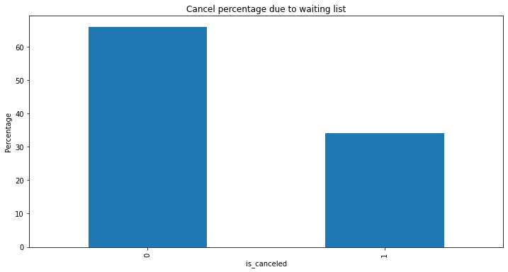
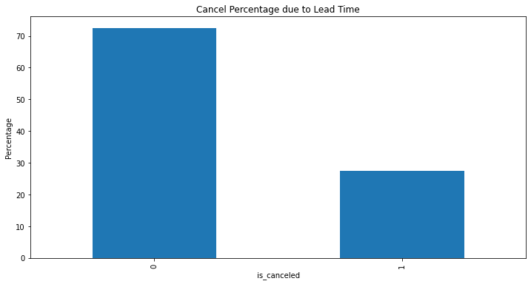
Waiting time(days)
Cancellation related analysis
Lead Time
The parameters like lead time and days in waiting list have no significant impact on the cancellation rate.

Slide 17
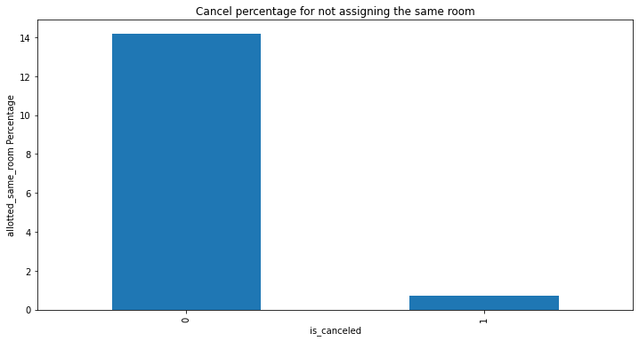
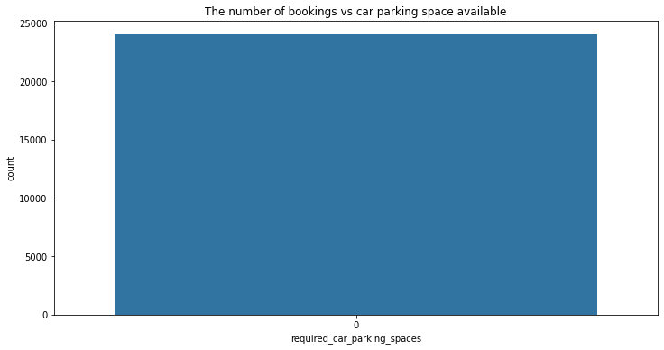
Cancellation for not assigning same room
Car parking space
The booking change from assigned room to reserved room parameter not had any influence on cancellation of bookings.
Main reason for cancellation has been because of no car parking space.

Slide 18
Time and Stay related Analysis
Customer type with maximum Average Daily Rate
Type of customers booking the most
Best time to book a hotel room
Countries from which most customers are coming

Slide 19
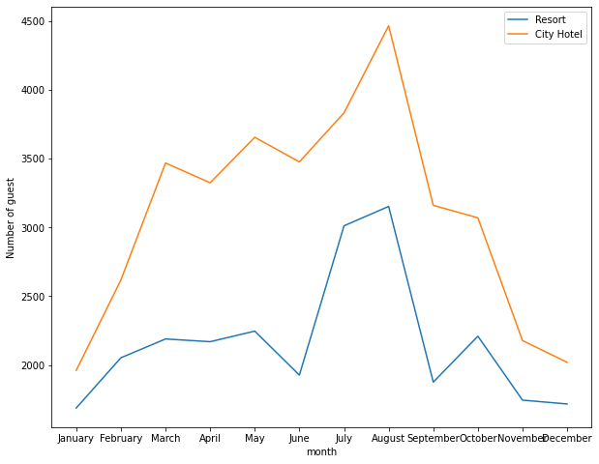
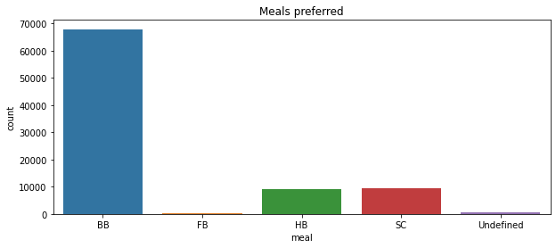
Best time to book a hotel room
Meal preferred
As per the plot graph, we can conclude that most of the customers visit in the month of August.
In this analysis, we have concluded that the most preferred meal type by the customer is Bed and Breakfast(BB).

Slide 20
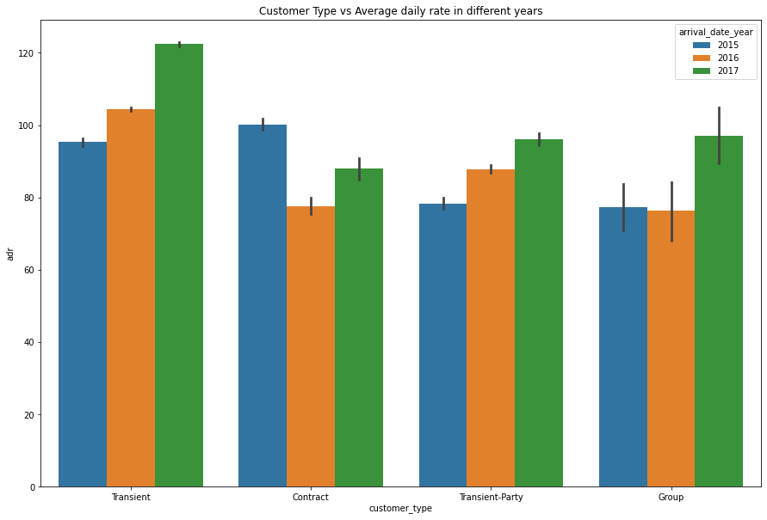
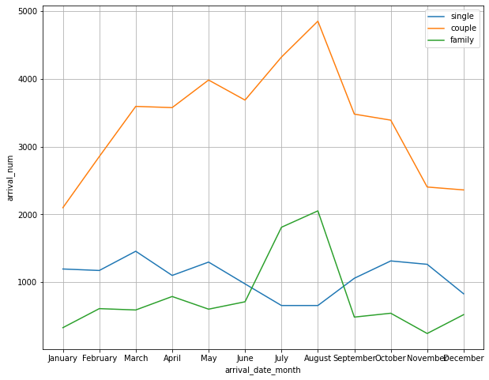
Customer type with maximum Average Daily Rate
Type of customers booking the most
We can conclude that, transient customer type generates maximum adr. The adr of transient-party has been increasing with the year. The group customer type does not show much of a progression.
According to the above graph, it shows that mostly couples or families that has been visiting during the month of July and August.

Slide 21
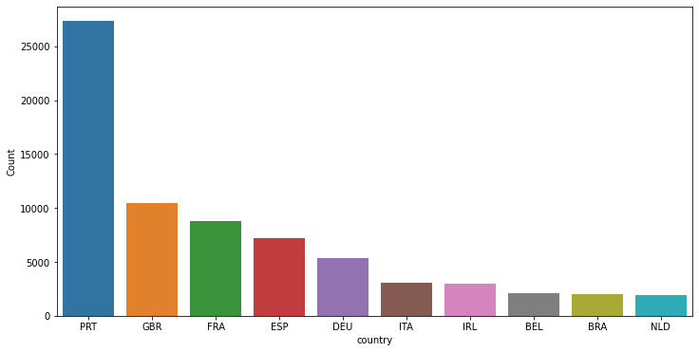
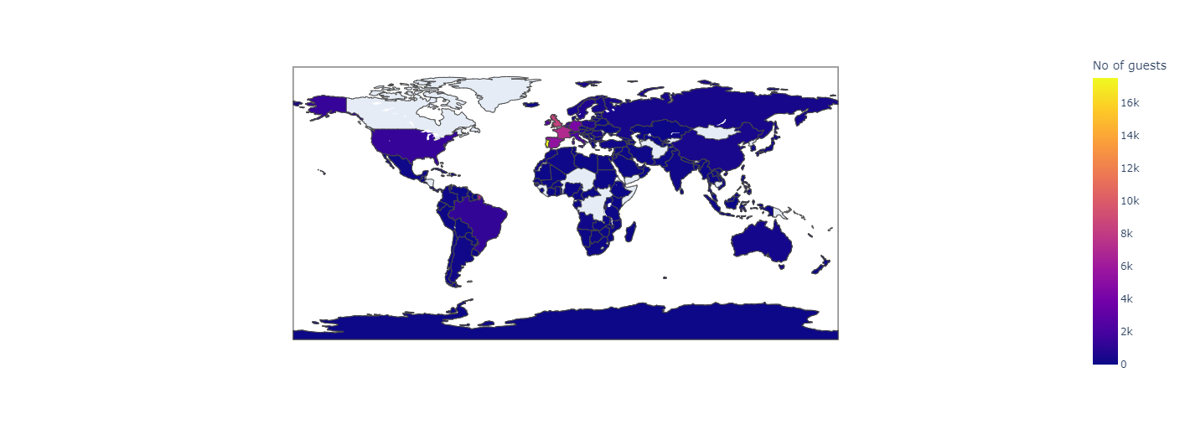
Countries from which most customers are coming
Most of the guests were from Portugal with 25k customers. Second by Great Britain with 10k customers. Followed by France, Spain and Germany respectively.

Slide 22
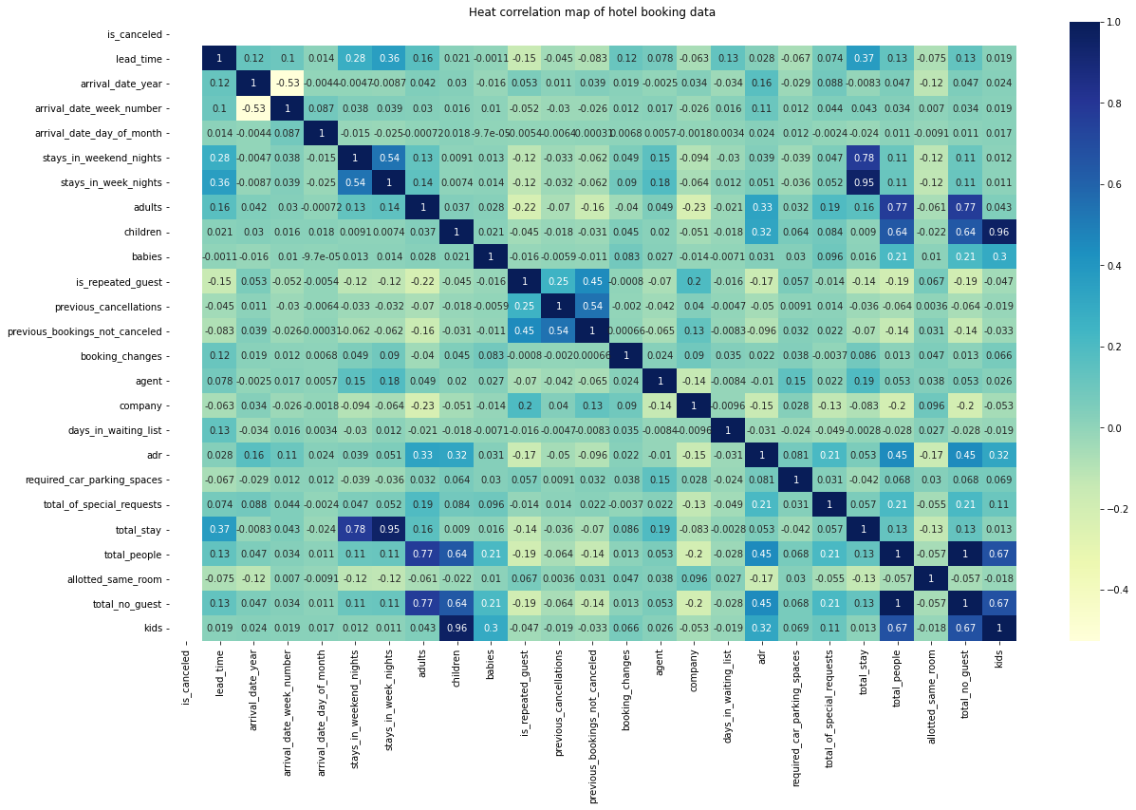
Heat Correlation Map
The average daily rate is positively correlated with total number of guest.Hence we can understand that when number of guest increases ,the average daily rate of hotel also increases with it.
The average daily rate is positively correlated with the number of special request.Hence we can understand that when the number of special request increases the revenue of the hotel increases.
The total number of days stay and lead time have slight positive correlation to each other. Thus we can say that higher number of days stay result in higher lead time.

Slide 23
Challenges
A lot of null values were present in the dataset.
There were a lot of duplicate data.
Removing the outliers from the given dataset.
Selecting appropriate visualization techniques was a tedious job.

Slide 24
Thank You !!!

